Slide 1
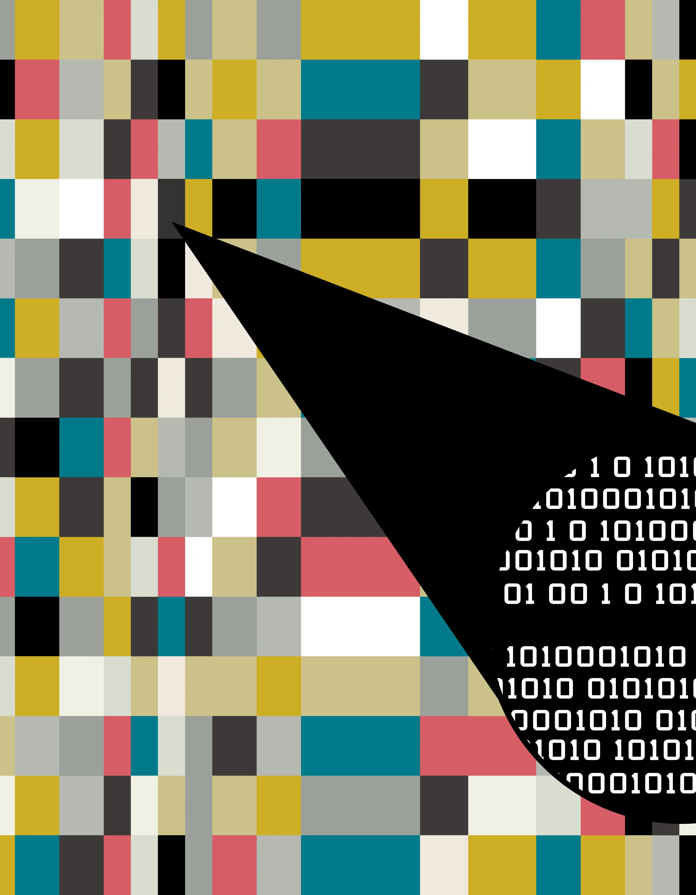
A Wavelet-Based Approach for Authenticating Medical Images and Extracting Patient Information
Arnab Ghosh (CSUG/111/21
Jit Malla (CSUG/113/21)
Raihan Uddin (CSUG/182/21)

Slide 2
Context
1
2
3
4
5
Abstract
Area of Steganography
Experiment Domain
Literature Survey
Proposed Method

Slide 3
Context
6
7
8
9
10
Experiment and result
Sample Experiment
Comparison
References
Conclusion

Slide 4
Abstract
we present a novel approach to medical image steganography that leverages the Discrete Wavelet Transform (DWT), histogram shifting, and Arnold's cat map for enhanced security and robustness. First, the medical image is decomposed into subfrequencies using DWT. Histogram shifting is then employed to embed watermark information with minimal distortion and high capacity. Arnold's cat map is applied to scramble the watermark image.
The proposed steganographic technique ensures that the medical images remain diagnostically accurate while embedding crucial patient or institutional data securely. This work represents a significant step forward in the field of medical image steganography, providing a robust and secure solution for protecting sensitive medical information.

Slide 5
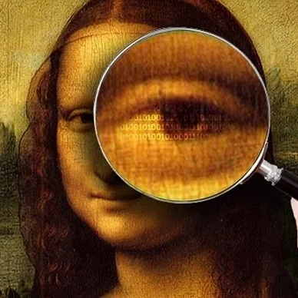
Area of Steganography

Slide 6
What is Steganography ?
Steganography is the practice of hiding information within other seemingly ordinary messages or media. The word “Steganography” is made from two Greek words: "steganos," meaning covered, and "graphein," meaning writing.
In simple terms, this technique actively hides data to make it hard to find, ensuring only the chosen recipient knows it exists.
How Steganography Works ?
Steganography works by embedding hidden information into an ordinary file or communication channel. To encode secret data, one might alter specific bits in an image or embed a hidden message within the noise of an audio file. The goal is to make the presence of the hidden data undetectable to casual observers or automated analysis.

Slide 7
What Are the Different Types of Steganography Used Today ?
Modern steganography includes several types:
Text Steganography
Image Steganography
Audio Steganography
Video Steganography
Network Steganography

Slide 8
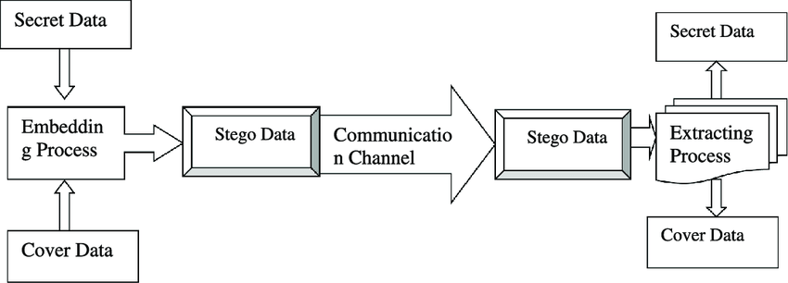
How does it work ?
In memory, an image is represented as a N*M (for greyscale images) or N*M*3 (for colour images) matrix, with each entry representing the intensity value of a pixel. Image steganography embeds a message into an image by changing the values of some pixels chosen by an encryption algorithm.

Slide 9
Applications of Steganography
Steganography
Secure Communication
Digital Watermarking
Cybersecurity
Covert Operations and Espionage
Anti-Censorship and Privacy Protection
Data Exfiltration Prevention
Secure Communication
Digital Watermarking
Cybersecurity
Covert Operations and Espionage
Anti-Censorship and Privacy Protection
Data Exfiltration Prevention

Slide 10
Applications In medical Domain
Steganography in medical domain
Patient Data Confidentiality
Secure Telemedicine
Integrity Verification
Medical Image Authentication
Embedding Diagnostic Information
Data Hiding for Efficient Storage
Steganography in the medical domain has several critical applications, primarily focused on ensuring the confidentiality, integrity, and security of sensitive medical data. Some key applications include:
Patient Data Confidentiality
Secure Telemedicine
Integrity Verification
Medical Image Authentication
Embedding Diagnostic Information
Data Hiding for Efficient Storage

Slide 11
Experiment Domain

Slide 12
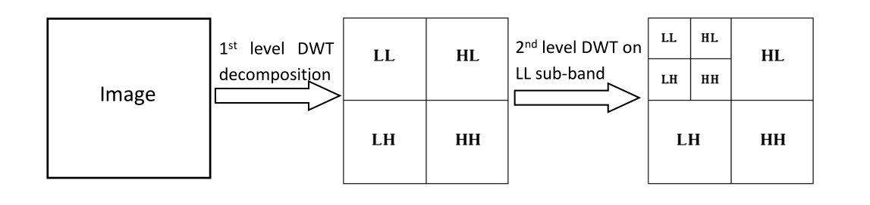
Discrete Wavelet Transform (DWT)
DWT is a transform domain technique where any signal can be analysed into its average and detail sub-bands. The DWT is used to decompose the image into non-overlapping sub-bands, namely, approximation (LL), horizontal (LH), vertical (HL) and diagonal (HH). We can further decompose the ‘LL’/or other sub-band to obtain wavelet coefficients at multiple level.

Slide 13
Histogram shifting
Histogram shifting is a reversible data hiding technique that utilizes the histogram of pixel values in an image to embed secret data. This method exploits the redundancy in pixel intensity values to conceal information with minimal distortion, ensuring that the original image can be perfectly restored after the hidden data is extracted. The key steps involved in histogram shifting are as follows:
Histogram Calculation: The pixel values of the cover image are analyzed to construct a histogram, which represents the frequency distribution of these values.
Peak and Zero Points Identification: The histogram is examined to identify peak points (intensity values with the highest frequency) and zero points (intensity values with zero frequency). The peak points are used for data embedding, while zero points facilitate the reversible nature of the method.

Slide 14
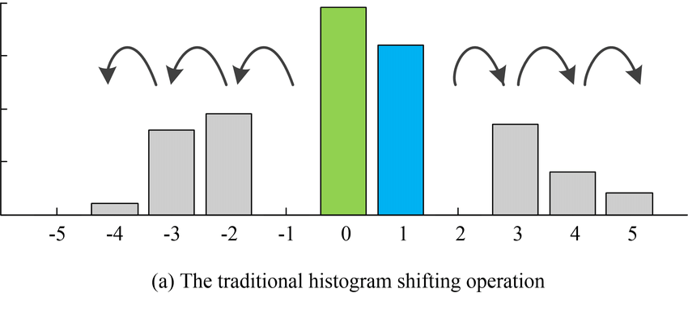
Data Embedding: Secret data bits are embedded by shifting the pixel values. Pixels corresponding to the peak point are shifted towards the zero point to create space for the secret data. Each bit of the secret data can be embedded by modifying the pixel values around the peak point.
Reconstruction and Extraction: During extraction, the process is reversed. The embedded data is retrieved by examining the modified pixel values, and the original image is restored by shifting the pixels back to their original positions.

Slide 15
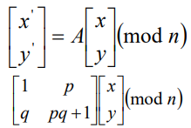
Arnold’s Cat Map
Arnold's Cat Map, a two-dimensional chaotic technique used to shuffle pixel positions in an image without losing any data. The Cat Map equation transforms pixel coordinates to create a new image. By iterating this transformation randomly for a certain number of times, a scrambled image is generated, ensuring digital image encryption. This scrambled image can be safely transmitted over communication channels without revealing its content. At the receiving end, reversing the process brings back the original image, ensuring secure transmission and protection against unauthorized access
Where p and q are the positive integers
(x’,y’) is the correspondence new location of the original pixel

Slide 16
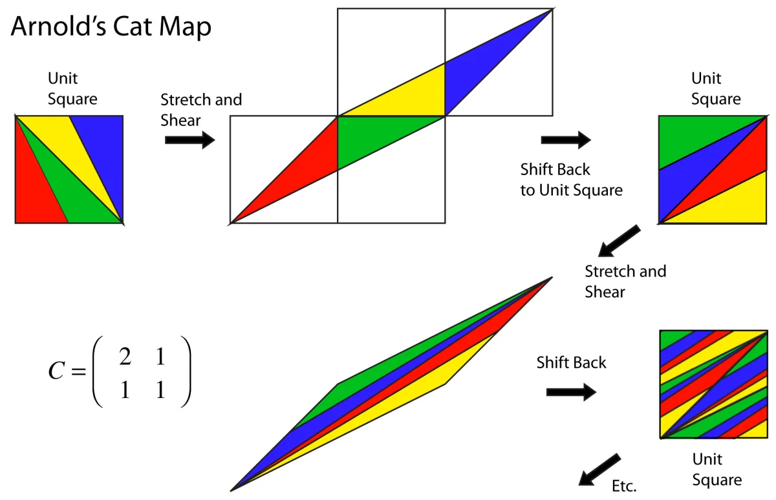
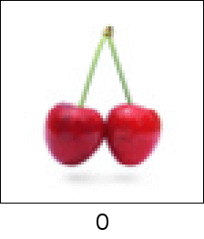

Slide 17
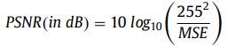
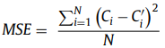
Performance Evaluation Techniques
Peak Signal to Noise Ratio(PSNR): PSNR is one of the popular and top notch metric used to measure the quality of the watermarked-image by analyzing the mean squared error value between the Cover and the watermarked-image. For 8-bit images, PSNR is calculated as:
And MSE is calculated as:
N is the in the watermarked-image and C_{i}’ is the intensity of i^{th} pixel in the cover image. number of cover image pixels, C_{i} is the intensity of i^{th} pixel

Slide 18
Literature Survey

Slide 19
Sl no. | Author | Paper | Method | Result | Year
1. | Meghana, Umesh D R | Image Steganography based on Histogram Shifting | Spatial domain, Histogram Shifting, Block-Based | PSNR: 36.21 dB | 2019
2. | Yujie Jiaa , Zhaoxia Yina, Xinpeng Zhangb , Yonglong Luo | Reversible data hiding based on reducing invalid shifting of pixels in histogram shifting | Image Texture, Checkerboard Pattern, Fluctuation Value Calculation, Prediction Error Adjustment | PSNR: Greater than 58 dB for "Baboon" image at 0.02 bits per pixel (bpp) | 2019
3. | C. V. Kumar, V. Natarajan and Deepika Bhogadi | High Capacity Reversible Data hiding based on histogram shifting for Medical Images | Modified Histogram Shifting, Hierarchical Block Division, Recursive Looking-Ahead Estimation | PSNR: Up to 59.05 dB for non-recursive, 58.8 dB for recursive methods MSE: Ranges from 0.08 to 0.37 | 2013

Slide 20
Sl no. | Author | Paper | Method | Result | Year
4. | Hiba Abdel-Nabi and Ali Al-Haj | Medical Imaging Security Using Partial Encryption and Histogram Shifting Watermarking | Joint Reversible Data Hiding and Encryption, Substitution-Based and Transposition-Based Techniques | PSNR: 56.60 dB for directly decrypted watermarked images 58.81 dB for partially watermarked images Infinite PSNR for fully restored images | 2017
5. | Li-Chin Huang, Lin-Yu Tseng , Min-Shiang Hwang | A reversible data hiding method by histogram shifting in high quality medical images | Histogram Shifting, Block-Based, Difference Histogram Calculation | PSNR: Above 61 dB for signed 16-bit depth images Above 74 dB for unsigned 16-bit depth images | 2013

Slide 21
Sl no. | Author | Paper | Method | Result | Year
6. | Chin-Chen Chang1 , Thai-Son Nguyen , and Chia-Chen Lin | Reversible Image Hiding for High Image Quality based on Histogram Shifting and Local Complexity | Histogram Shifting, Local Complexity Calculation, Peak Identification, Grayscale Conversion | PSNR: 49.31 dB for "Lena" 49.37 dB for "Airplane" 51.05 dB for "Baboon" 49.18 dB for "Peppers" 49.04 dB for "Barbara" 51.04 dB for "Zelda" 52.78 dB for grayscale Kodak images at Ts = 10 49.73 dB for grayscale Kodak images at Ts = 30 48.85 dB for grayscale Kodak images at Ts = 50 48.46 dB for grayscale Kodak images at Ts = 70 MSE: Not explicitly provided SSIM: High visual quality implied, specific values not provided | 2014
7. | A. A. Karawia | Medical image steganographic algorithm via modified LSB method and chaotic map | Modified LSB, One-Dimensional Chaotic Map Encryption, Two-Dimensional Chaotic Map for Pixel Selection | PSNR: High values indicating minimal distortion MSE: Low values indicating minimal distortion SSIM: High structural similarity indicating minimal distortion | 2021

Slide 22
Sl no. | Author | Paper | Method | Result | Year
8. | De Rosal I.M. Setiadi, Md. Fadhil, Eko Hari Rachmawanto, Christy Atika Sari | Secure Reversible Data Hiding in the Medical Image using Histogram Shifting and RC4 Encryption | Histogram Shifting, RC4 Encryption | PSNR: Approximately 48.34 dB to 51.81 dB MSE: 0 to 0.9525 SSIM: Approximately 0.9855 to 0.9994 | 2019
9. | Wien Hong , Tung-Shou Chen ,Chih-Wei Shiu | Reversible Data Hiding Based on Histogram Shifting of Prediction Errors | Histogram Shifting of Prediction Errors (HSPE), RSA/DES Encryption | PSNR: Above 48 dB Embedding Capacity: Average 4.74 times higher than Ni et al.'s method Improvement in Stego Image Quality: Average of 7.99 dB higher under the same embedding | 2008

Slide 23
Proposed Method

Slide 24
Watermarking Medical images is crucial for protecting patient’s information. For watermark embedding Histogram Equalization has been proposed. To enhance the security we have used two different methods DWT, Arnold cat Map. All have been experimented with SIPI and medical images.
Embedding Process:
Wavelet Transform: The cover image undergoes a forward wavelet transform (FWT) to obtain its frequency-domain representation. This is done to decompose the image into its low-frequency and high-frequency components.
Partitioning: The frequency-domain representation obtained from the wavelet transform is partitioned into two parts: LL (approximation) and HH (details).
Arnold's Cat Map Transformation: The secret image undergoes Arnold's Cat Map transformation to introduce chaos and enhance security. This step involves iteratively applying Arnold's Cat Map to the secret image.
Encode Secret Image: The secret image is converted into binary format. This binary message is then encoded into the LL (low-frequency) part of the cover image using a specific encoding technique.
Embed SHA-256: The SHA-256 hash of the secret image is calculated and embedded into the HH (high-frequency) part of the cover image. This hash serves as a verification mechanism to ensure the integrity of the secret image during extraction.
Inverse Wavelet Transform: The modified frequency-domain representation is then transformed back into the spatial domain using the inverse wavelet transform (IWT) to obtain the stego image.

Slide 25
Extraction Process:
Wavelet Transform: Similar to embedding, the stego image undergoes a forward wavelet transform to obtain its frequency-domain representation.
Partitioning: The frequency-domain representation is partitioned into LL and HH parts.
Extract Secret Image: The encoded binary message is extracted from the LL part of the stego image using the corresponding decoding technique.
Extract SHA-256: The SHA-256 hash embedded in the HH part of the stego image is extracted.
Decode Secret Image: The extracted binary message is decoded to obtain the secret image in binary format.
Arnold's Cat Map Reversion: If necessary, an Arnold's Cat Map reversion process is applied to revert the chaotic transformation applied during embedding, restoring the original secret image.
SHA-256 Verification: The SHA-256 hash of the extracted secret image is recalculated. If it matches the extracted hash from the stego image, it indicates that the extraction was successful and the secret image integrity is preserved.
Final Output: The extracted secret image is obtained, and the process is complete.
These steps outline the general procedure for embedding and extracting a secret image within another image using the techniques described in the provided code.

Slide 26
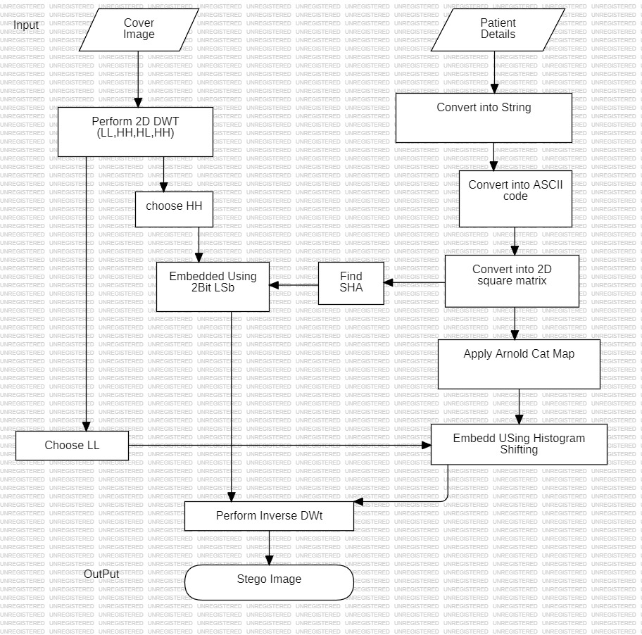
Embedding Process:
Algorithm1: Embedding (COVER, WI)
Step 1: Take 1-level 2D DWT of COVER image.
Step 2: Apply FWT to decompose COVER image into frequency components.
Step 3: Split transformed image into LL (low-frequency) and HH (high-frequency) components.
Step 4: Apply Arnold's Cat Map to secret image for chaos.
Step 5: Convert secret image to binary and embed into LL.
Step 6: Compute SHA-256 hash of secret image and embed into HH.
Step 7: Apply IWT to reconstruct stego image from modified components.

Slide 27
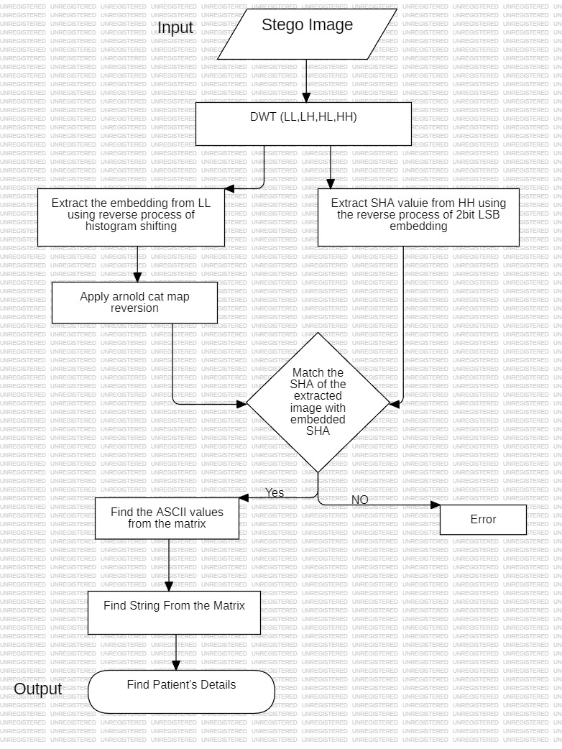
Extraction Process:
Algorithm2: Extraction (stego, Bp)
Step 1: Apply FWT to stego image for frequency component separation.
Step 2: Split FWT result into LL and HH components.
Step 3: Decode embedded binary message from LL.
Step 4: Retrieve embedded SHA-256 hash from HH.
Step 5: Convert binary message into secret image.
Step 6: Reverse Arnold's Cat Map transformation if applied.
Step 7: Calculate SHA-256 hash of extracted secret image for integrity verification.
Step 8: Extract patient info from secret image.

Slide 28
Experiment & Result

Slide 29
DATASET:
21 level step wedge
Airplane
boat.512
APC
16x16_GRAYSCALE
Car and APCs
Truck
Truck and APCs

Slide 30
MSE, PSNR & SSIM Result Between Cover Images and Stego Images:
Cover Images | Watermark Image | MSE | PSNR | SSIM
21 level step wedge | 16x16_GRAYSCALE | 0.077847 | 59.21841 | 0.999627
Airplane | 16x16_GRAYSCALE | 0.058697 | 60.44466 | 0.999602
boat.512 | 16x16_GRAYSCALE | 0.048534 | 61.27031 | 0.999765
APC | 16x16_GRAYSCALE | 0.050457 | 61.10159 | 0.999602
Car and APCs | 16x16_GRAYSCALE | 0.046646 | 61.44265 | 0.999776
Truck | 16x16_GRAYSCALE | 0.048691 | 61.25633 | 0.999742
Truck and APCs | 16x16_GRAYSCALE | 0.044632 | 61.63434 | 0.999906

Slide 31
Sample Experiment

Slide 32
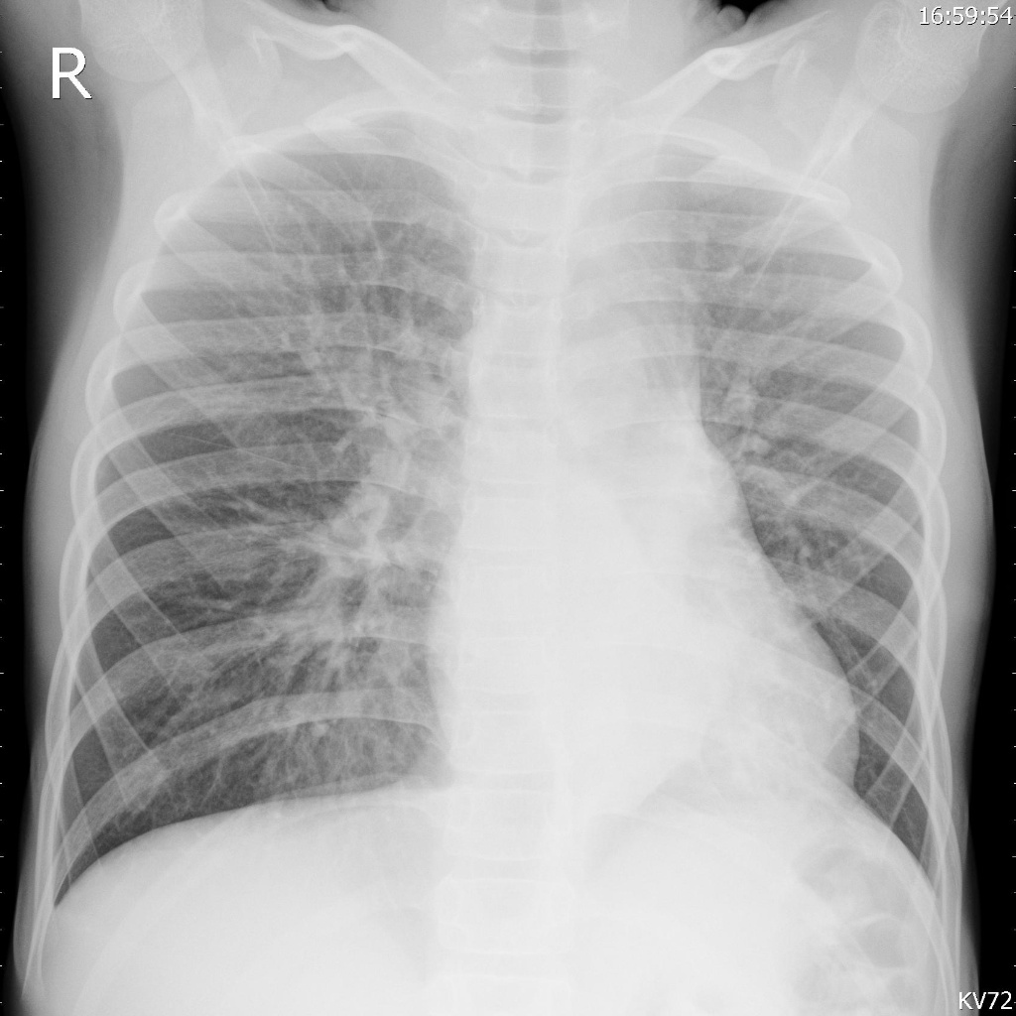
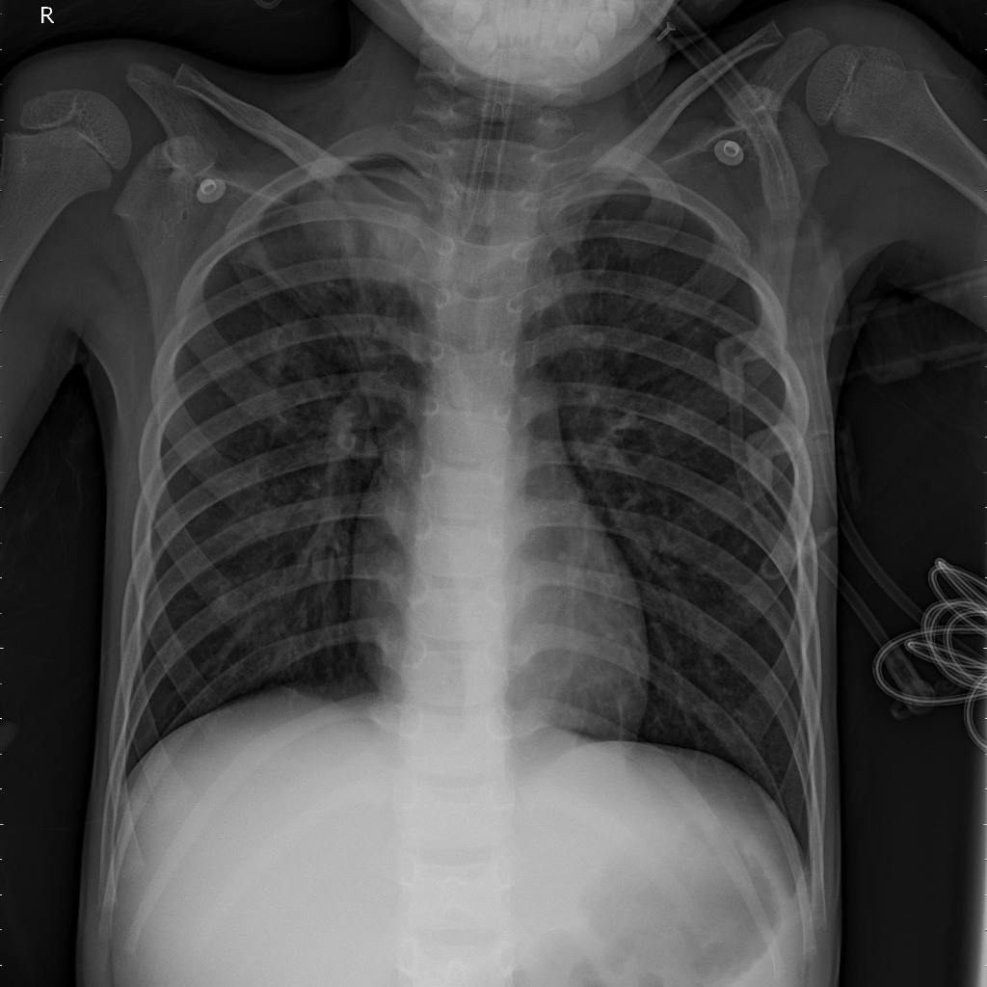
DATASET
BACTERIA-2514247-0001
Watermarking Data of Patient(W)
VIRUS-9694192-0002

Slide 33


Cover Images and Stego Image after embedding Patient details(W):
Cover Images
Stego Images
W
W

Slide 34
Comparison

Slide 35
Comparison between PSNR of [3] and avg PSNR of our proposed method

Slide 36
Comparison between PSNR and MSE of [8] and avg PSNR and MSe of our proposed method

Slide 37
References

Slide 38
Meghana, Umesh D R , “Image Steganography based on Histogram Shifting” in IJREAM, ISSN:2454-9150, Vol- 05, Issue- 02, pp. 654-657.(2019)
Yujie Jiaa , Zhaoxia Yina, Xinpeng Zhangb , Yonglong Luo, “Reversible data hiding based on reducing invalid shifting of pixels in histogram shifting”.(2019)
C. V. Kumar, V. Natarajan and Deepika Bhogadi, “High Capacity Reversible Data hiding based on histogram shifting for Medical Images”, in International conference on Communication and Signal Processing, April 3-5, 2013, India , pp. 730-733. (2013)
Hiba Abdel-Nabi and Ali Al-Haj, “Medical Imaging Security Using Partial Encryption and Histogram Shifting Watermarking”,published in 2017 8th International Conference on Information Technology (ICIT), pp. 802-807.(2017)
Li-Chin Huang, Lin-Yu Tseng , Min-Shiang Hwang, “A reversible data hiding method by histogram shifting in high quality medical images” in The Journal of Systems and Software, Vol- 86, Issue- 3, pp. 716-727, (2013). DOI: https://doi.org/10.1016/j.jss.2012.11.024
Chin-Chen Chang1 , Thai-Son Nguyen , and Chia-Chen Lin, “Reversible Image Hiding for High Image Quality based on Histogram Shifting and Local Complexity” in International Journal of Network Security, Vol.16, No.3, PP.208-220, May (2014)

Slide 39
A. A. Karawia, “Medical image steganographic algorithm via modified LSB method and chaotic map”, in IET Image Processing WILEY, Vol-15 Isuue-11, pp. 2580-2590 (2021)
De Rosal I.M. Setiadi, Md. Fadhil, Eko Hari Rachmawanto, Christy Atika Sari, “Secure Reversible Data Hiding in the Medical Image using Histogram Shifting and RC4 Encryption” Published in 2019 International Seminar on Application for Technology of Information and Communication (iSemantic),pp.28-33, (2019). DOI:https://doi.org/10.1109/ISEMANTIC.2019.8884306
Wien Hong , Tung-Shou Chen ,Chih-Wei Shiu, “Reversible Data Hiding Based on Histogram Shifting of Prediction Errors” 2008 International Workshop on Education Technology and Training & 2008 International Workshop on Geoscience and Remote Sensing, pp. 578-581 (2008). DOI: 10.1109/ETTandGRS.2008.263

Slide 40
Conclusion

Slide 41
In conclusion, our project focuses on developing robust image watermarking techniques tailored for telemedicine. Ensuring secure transmission and confidentiality of medical images is vital for patient privacy and data integrity. While we didn't use Singular Value Decomposition (SVD), we explored Discrete Wavelet Transform (DWT), histogram shifting, and Arnold's Cat Map for embedding imperceptible watermarks in medical images. Our experiments demonstrate these methods maintain visual fidelity and diagnostic integrity, while resisting attacks like compression, noise, and cropping.
By refining these techniques and evaluating them with metrics like Peak Signal-to-Noise Ratio (PSNR), we balance imperceptibility and robustness, offering secure solutions for telemedicine. Our research contributes to the secure transmission of medical images, fostering trust among healthcare providers and patients, and enhancing the quality of telemedicine services.

Slide 42
Thank You

